Slide 1
A smart poultry litter tracking and alert system

Slide 2
Project Leadership
Project sponsor
Bharani kumar Depuru
Director and Co_Founder at Innodatatics
linkedin.com/in/bharanikumardepuru
PROJECT MENTOR
. Shubharata Kshirsagar
. Aniket Nandanwar

Slide 3
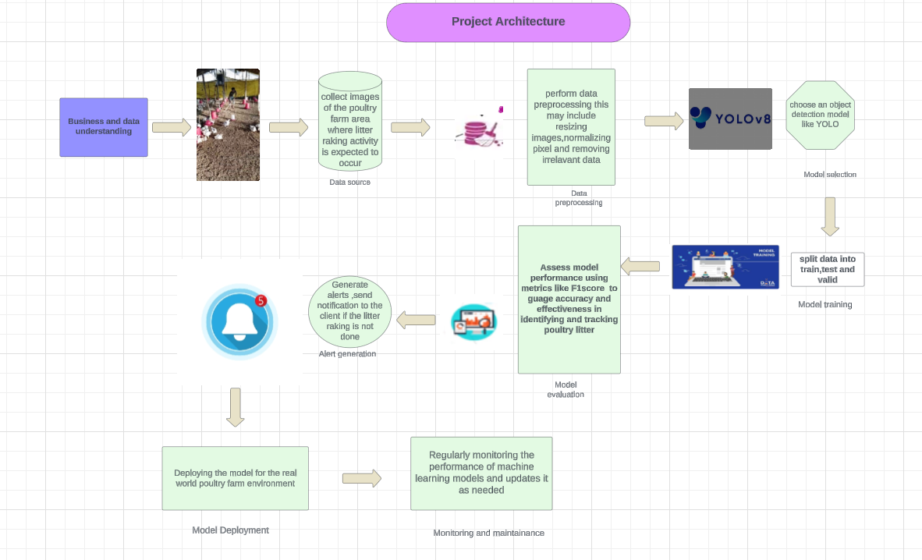


Slide 4
Contents
Business objective
Business Constraints
Project Architecture
Data collection and details
Exploratory Data Analysis
Visualization
Modeling
Evaluation
Deployment

Slide 5
CRISP-ML(Q) Methodology
There are six stages of CRISP-ML(Q) Methodology
1.Business and data understanding
2.Data preparation
3.model building
4.Model evaluation
5.Model deployment
6.Monitoring and maintenance

Slide 6
Poultry litter
Poultry litter is a mixture of bedding , manure, poultry exreta, split feed, and feathers produced by intensive poultry production.
Qualities of good bedding material:
1. Should quickly dry .
2. Should quickly absorb the faeces and keep the surface dry.
3. Should not be toxic to the birds and the handlers.
3. Should limit the production of ammonia.
4. Should not promote the growth of harmful pathogens.
5. It must be cheap and locally available.
6. It must be free from sharp objects and other objectionable materials.
7. Too much dried litter material causes dustiness in the farm
8. A good litter material is the one which breaks up when hand is open and the litter material with more moisture will form a ball in the hand

Slide 7
Business Problem
Neglecting proper litter management in poultry farming creates an environment that contributes to the buildup of pathogens and ammonia.This poses a threat to the respiratory well-being of birds ,increases the risk of diseases,and undermines the overall success and sustainability of the poultry enterprises
Business Objective :
Maximize poultry health
Business constraint :
Minimize the cost of the solution

Slide 8
Success criteria :
Business success criteria : Minimize manual efforts by at least 10% through the implementation of the automated litter management tracking system.
Machine Learning Success criteria : Achieve a minimum accuracy of 96% in detecting deviations from scheduled littering times and predicting poultry health outcomes through machine learning algorithms implemented in the tracking system.
Economic success criteria : Achieve a cost saving of atleast $1 million by the automated litter management tracking system.

Slide 9
Technical stacks
Python
Google Colab
Roboflow
Spyder
Twilio
Streamlit

Slide 10
Data collection and understanding
Business understanding :
. First understand the business problem
. And collected 10 research papers and gathered information from that research papers.
.Building a project Architecture based on that information
Data collection :
. Data is collected from u tube
. All litter raking videos are collected
. Frames were captured at 25fps
. Stored all datasets in drive

Slide 11
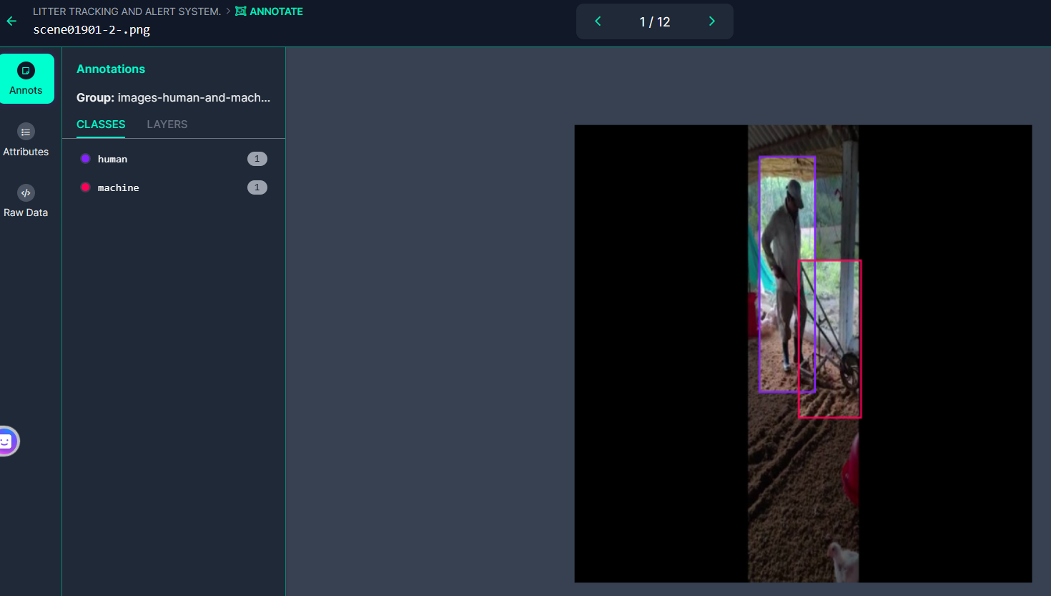
Tool used - Roboflow
Used Roboflow and the images collected were uploaded into Roboflow and started annotating images .
Classes were created human and machine and images were annotated by using bounding boxes.

Slide 12
System requirements
GPU for faster training of deep learning models.
Python with necessary libraries installed.
Sufficient storage place for storing datasets.

Slide 13
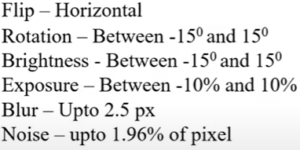
Data preprocessing and Augmentation
Once the data is collected we annotated the data in roboflow and given classes as human and machine.And avoided annotating the chicks ,waterers etc.
Applied auto orientation to images
Resized images to 640 x 640 pixels
AUGMENTATION :

Slide 14
Generating Dataset and model selection
Export Dataset : In roboflow exported the generated dataset in YOLOv8 format for further processing and training
Model selection : Multiclass object detection model __ YOLOv8

Slide 15
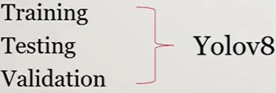
Model building

Slide 16
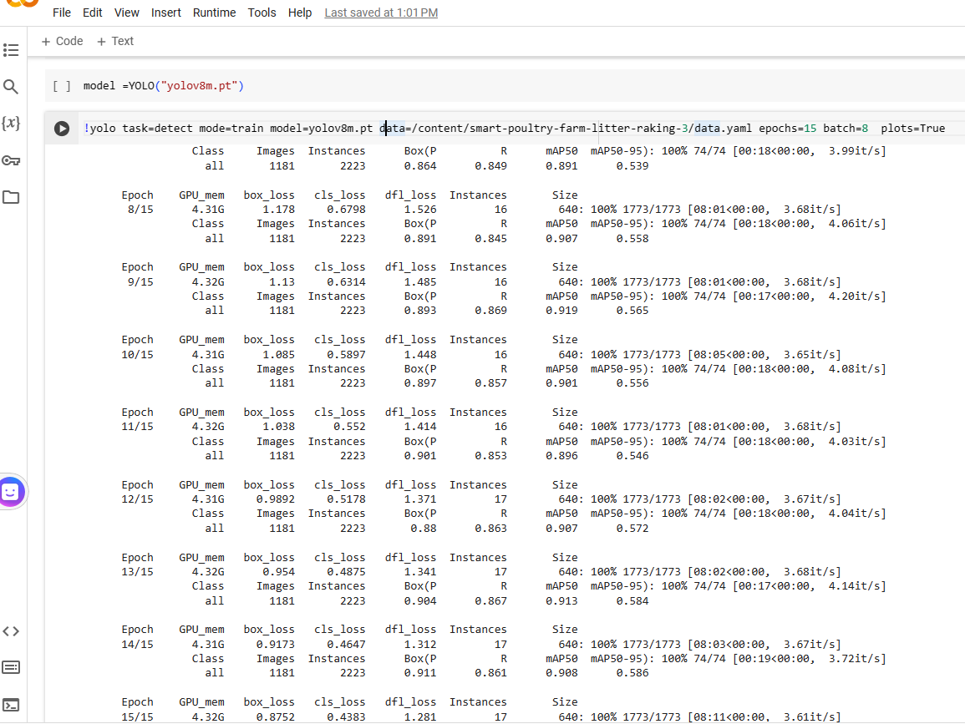
Model training

Slide 17
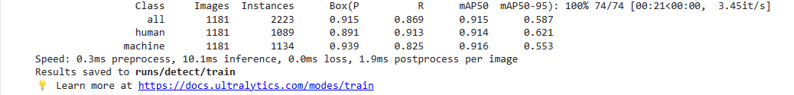
Model Accuracy comparision

Slide 18
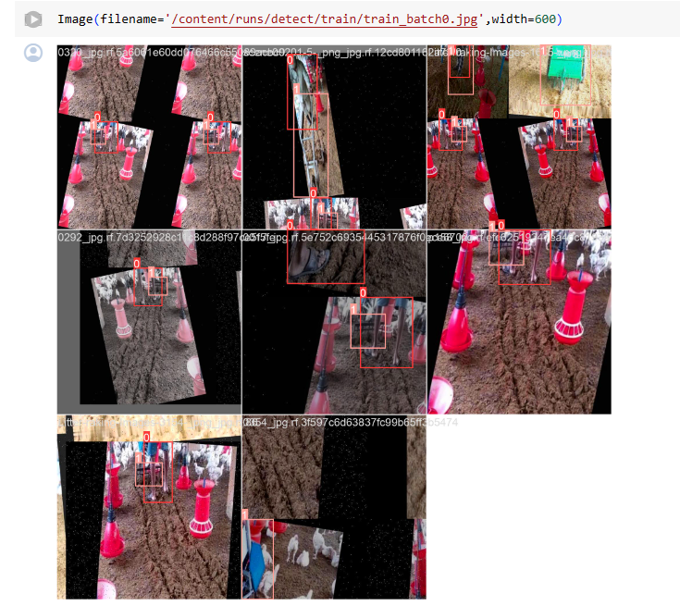
Screen shot of output

Slide 19
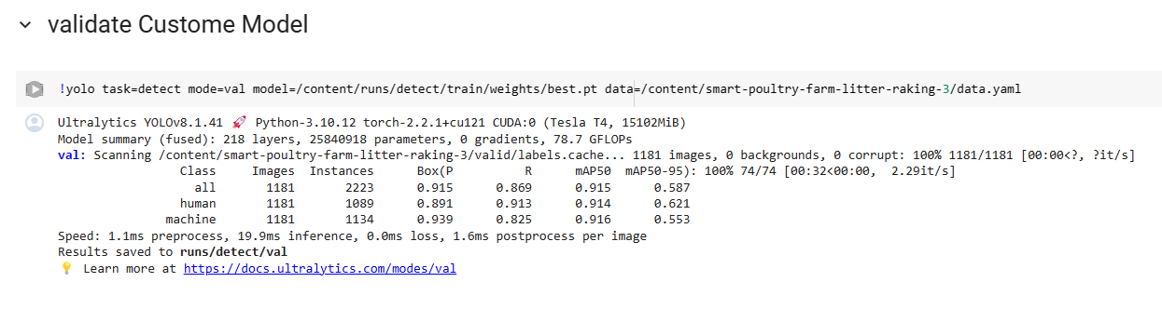

Slide 20
Alert system Development
Tool used – Twilio
. create Twilio account
. Get account SID ,Token and virtual phone number
. Twilio provide python code to integrate in your program

Slide 21
Model Deployment - Strategy
Streamlit is used for deploying the trained YOLOv8 model as a web application.
Generating SMS using Twilio
We generated Alert system and Notification

Slide 22
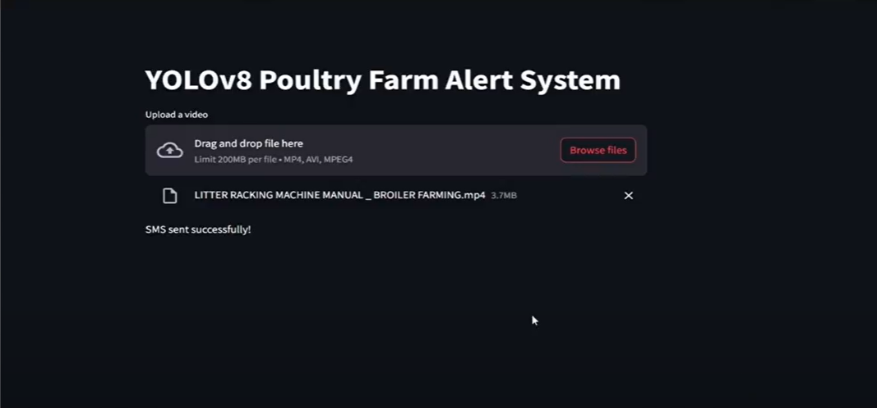
Screenshot of Deployment - output

Slide 23
Challenges
Imbalanced data and unstructured data
In Roboflow ,annotating images consumes more time to annotate (labeling data the classes are human and machine

Slide 24


